Slide 1



College ERP [Django] Category : DevOps using Amazon AWS
LEVEL 1 PPT PRESENTATION
Date :
Details of the Learner
Name : Aayush Sahay
Course : MCA 4th –AKU
Session : 2024- 2026
Enrollment : 24326711019
Guide : Dr. Amit Kumar Shukla (HOD-IT)
Institution : Cimage Center of Digital Technology
and Entrepreneurship, Patna
Course Code : 326 College Code : 711 For attainment of requirements for fulfillment of Masters in Computer Applications

Slide 2

College ERP [Django] Category : DevOps using Amazon AWS
Key Contents LEVEL 1 PPT PRESENTATION
Title of the Project
Introduction to Project
SRS
Process Logic
Gantt Chart
Data Dictionary
DFD
ER Diagram
Interfaces
Expected Report Generation
References & Bibliography
Future Scope of Project
Date :

Slide 3



College ERP [Django] Category : DevOps using Amazon AWS
LEVEL 1 PPT PRESENTATION
Introduction to Project
College ERP : Django & Pgsql
Deploying A web-app made in Django. Making a Docker container, communicates with pgsql. Running EC2 instance and making a demonstration for the idea of College ERP
Date :

Slide 4
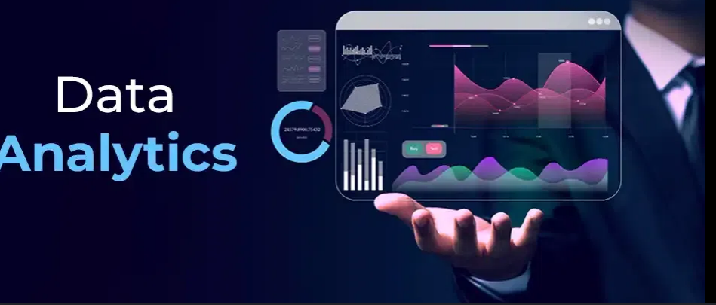

College ERP [Django] Category : DevOps using Amazon AWS
LEVEL 1 PPT PRESENTATION
2. Objectives of the Project
College ERP : Django & Pgsql
Agile Software Development for MIS
Deployment over cloud using AWS
Rapid Enhancement / Feature Integration
Version Controlling
Dashboard , Info. / HR Management.
Data Analytics using python
Date :

Slide 5
College ERP [Django] Category : DevOps using Amazon AWS
LEVEL 1 PPT PRESENTATION
3.1. SRS [Category of Project (Introduction)]
College ERP : Django & Pgsql
CATEGORY : DEVOPS using Amazon AWS It is a project demonstrating
The learning of Software Project Management,
Software Engineering & Testing and deploying it over Amazon cloud.
Date :

Slide 6
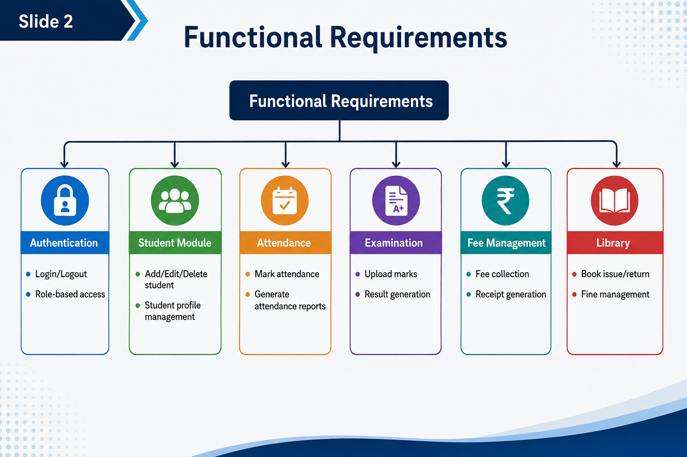
College ERP [Django] Category : DevOps using Amazon AWS
LEVEL 1 PPT PRESENTATION
3.2. SRS [Functional Requirements]
Functional Requirements
“ Features incorporated directly”
Auth server side (All actors) Modules for Actors. / Add new Actors.
Add Applications as requirement.
Management of Information
HOD can make Timetables.
HOD can assign Subjects.
Faculty can Make Att.
Admin can manage / monitor
Date :

Slide 7
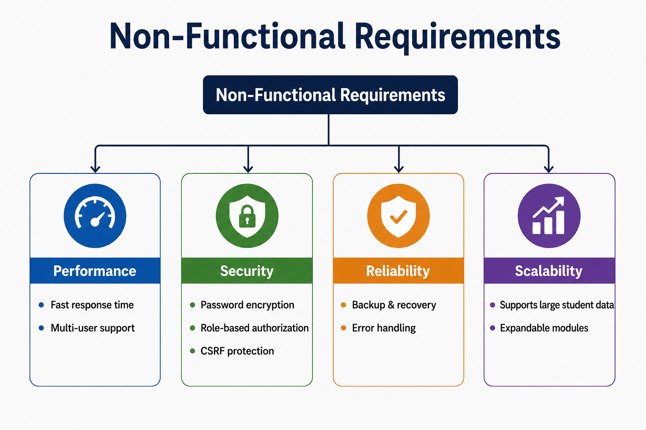
College ERP [Django] Category : DevOps using Amazon AWS
LEVEL 1 PPT PRESENTATION
3.3. SRS [Non Functional Requirements]
Non Functional Requirements
“ Features incorporated With
Supplementary ”
Management of Information
S/w system is faster.
Software system is organized
Role based access and store.
Data Retrieval fast by ensuring 3.5 Normal Form / BCNF.
Quick access and clean UI
Highly customizable on demand.
Date :

Slide 8
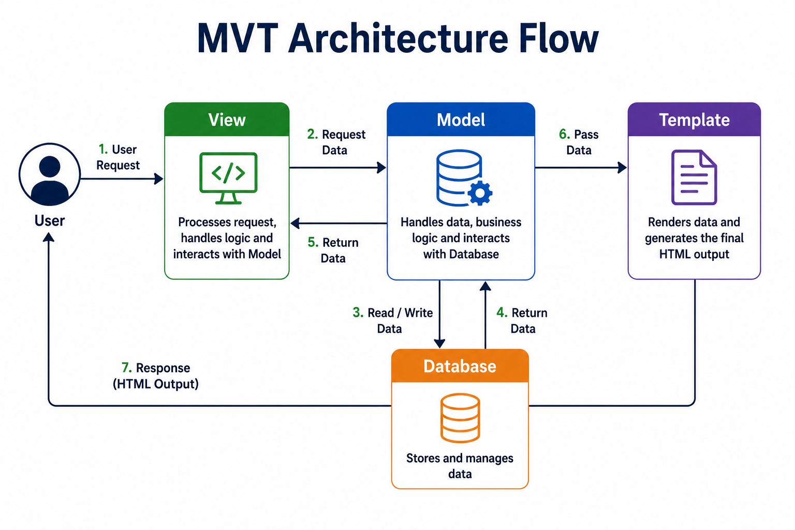
College ERP [Django] Category : DevOps using Amazon AWS
LEVEL 1 PPT PRESENTATION
3.4. SRS [Interface Design]
Interface Design
[MVT (Model View Template)]
Access By URL.
Views manage logic.
Models Manage Db.
Date :

Slide 9
College ERP [Django] Category : DevOps using Amazon AWS
LEVEL 1 PPT PRESENTATION
3.5. SRS [UI / UX]
How the Screens Look
Date :

Slide 10
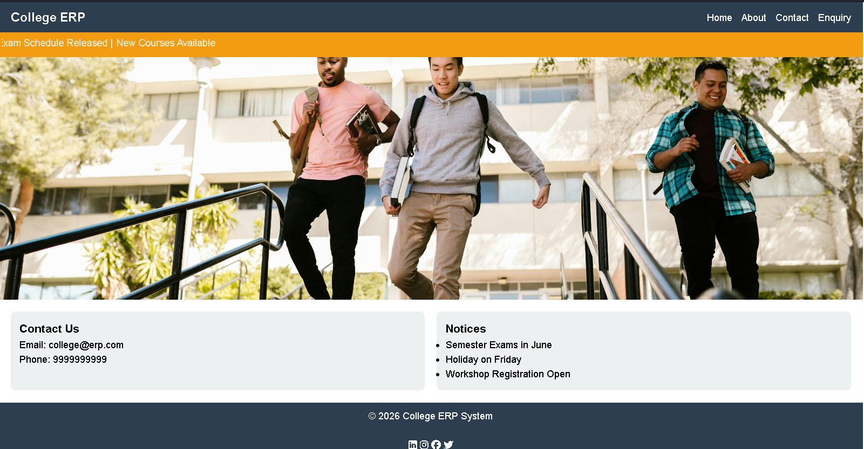
College ERP [Django] Category : DevOps using Amazon AWS
LEVEL 1 PPT PRESENTATION
Date :

Slide 11
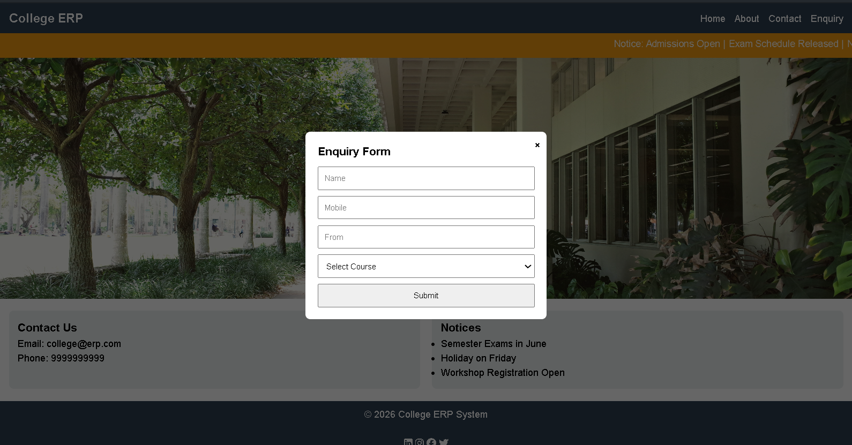
College ERP [Django] Category : DevOps using Amazon AWS
LEVEL 1 PPT PRESENTATION
Date :

Slide 12
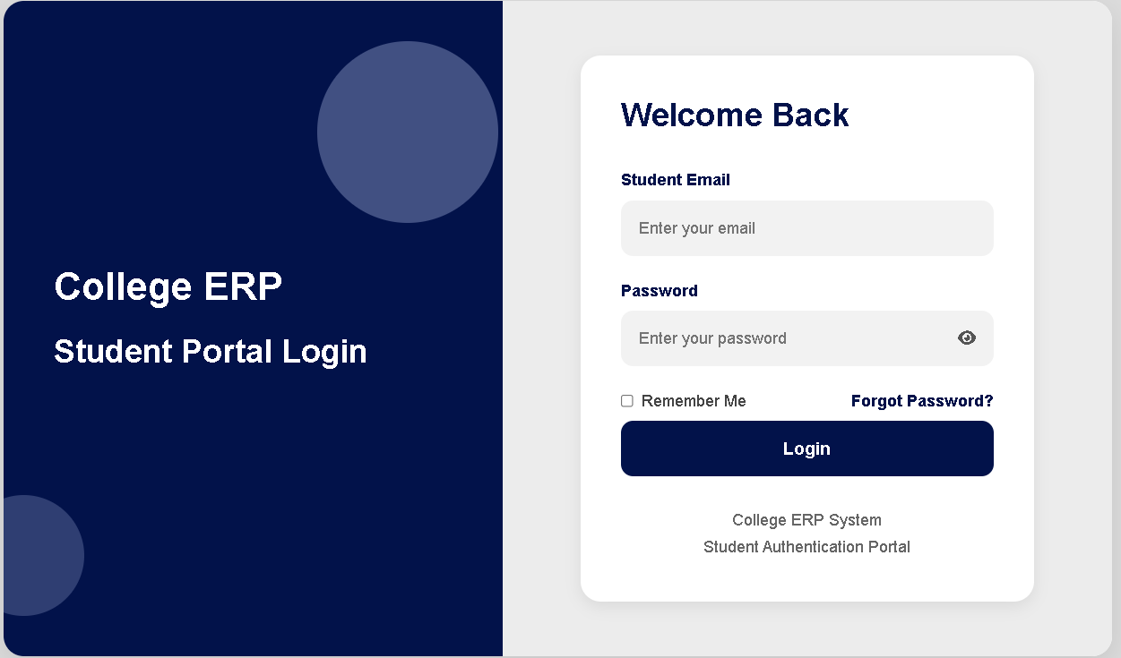
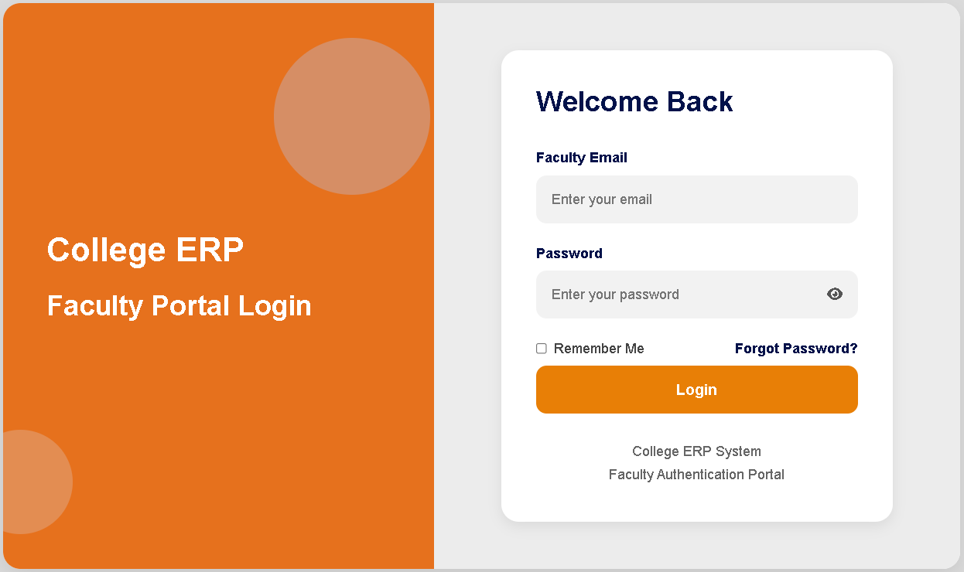
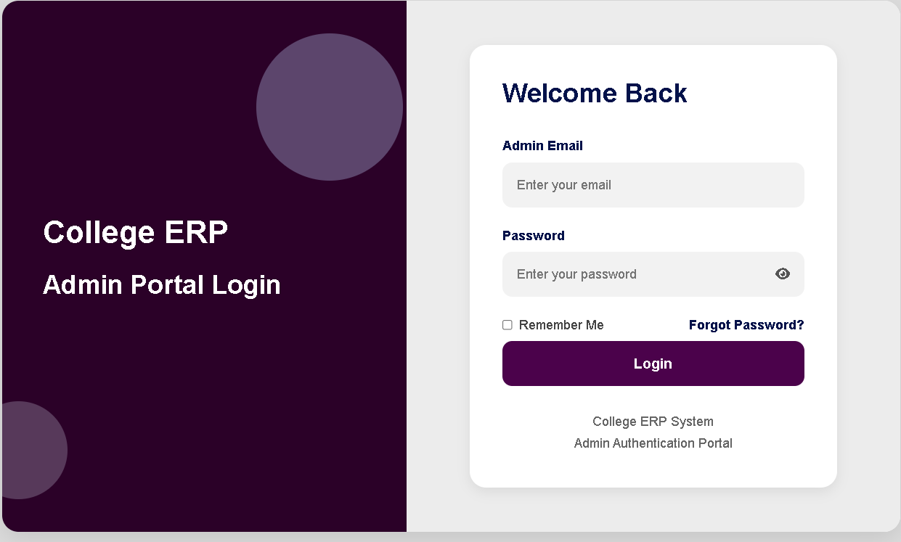
College ERP [Django] Category : DevOps using Amazon AWS
LEVEL 1 PPT PRESENTATION
Date :

Slide 13
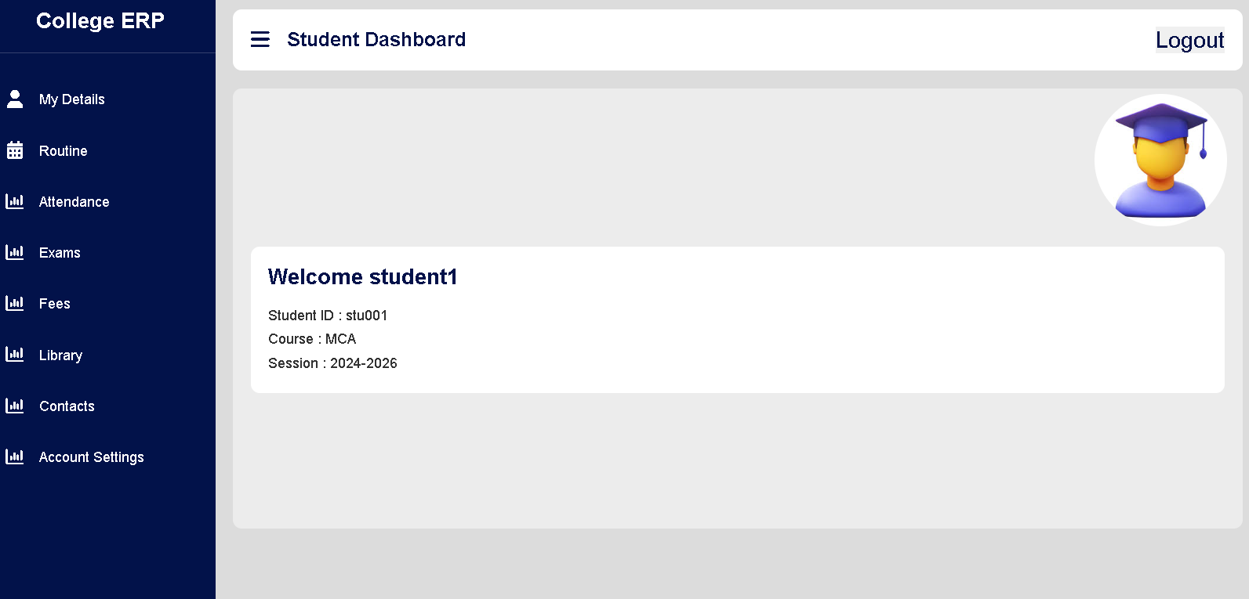
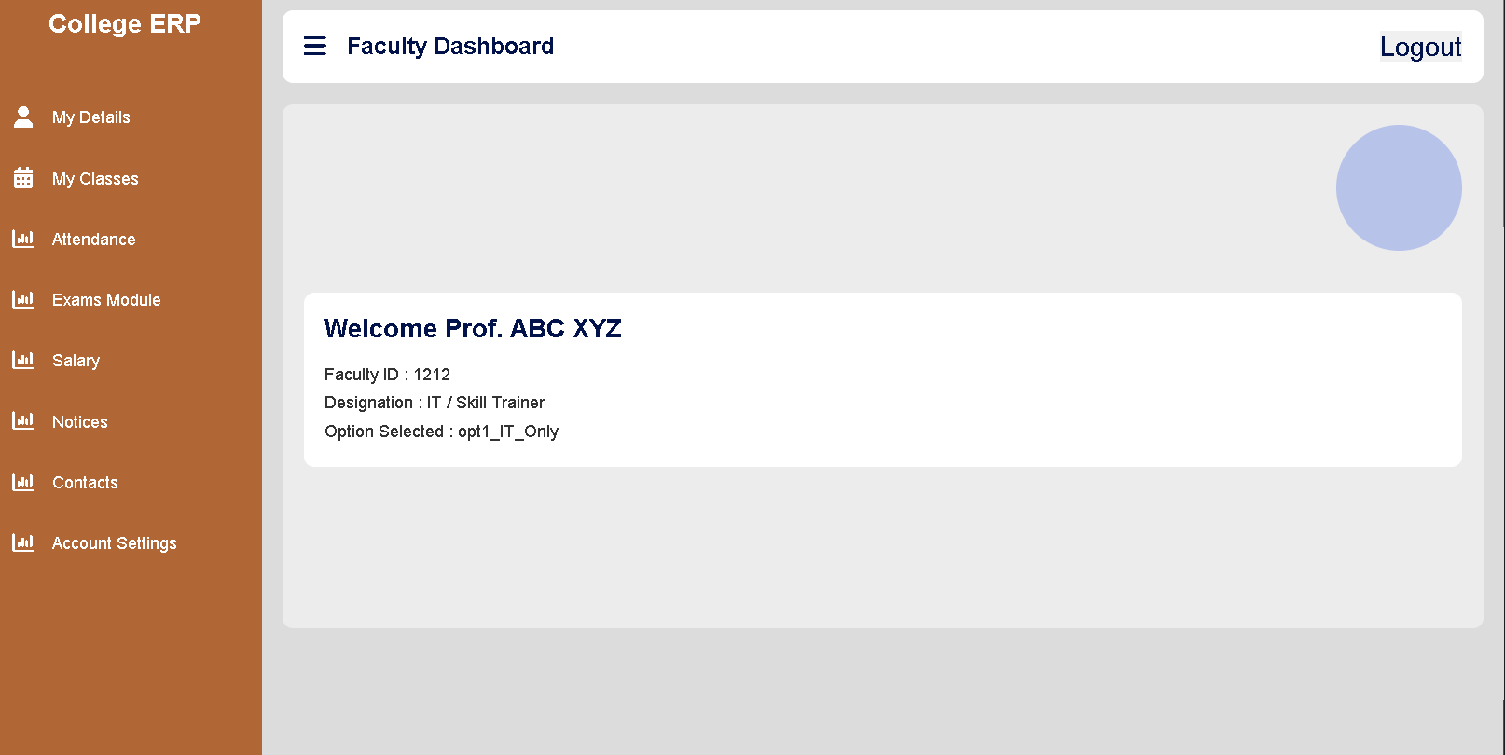
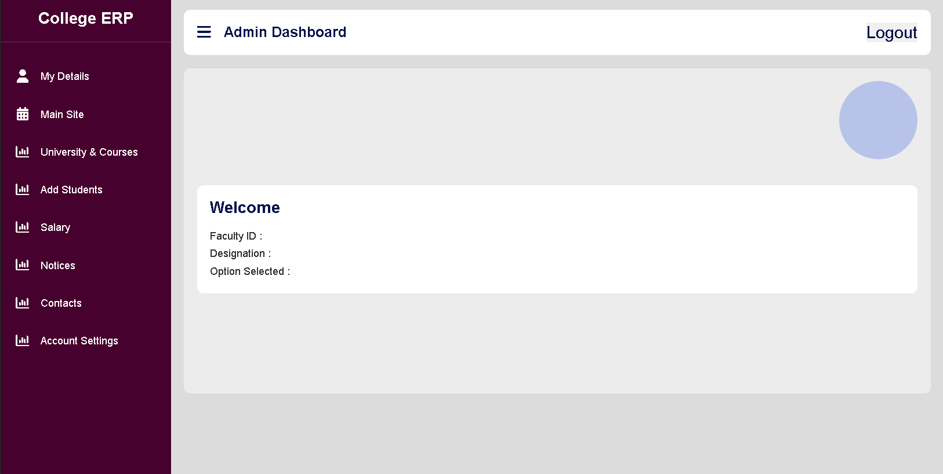
College ERP [Django] Category : DevOps using Amazon AWS
LEVEL 1 PPT PRESENTATION
Date :

Slide 14
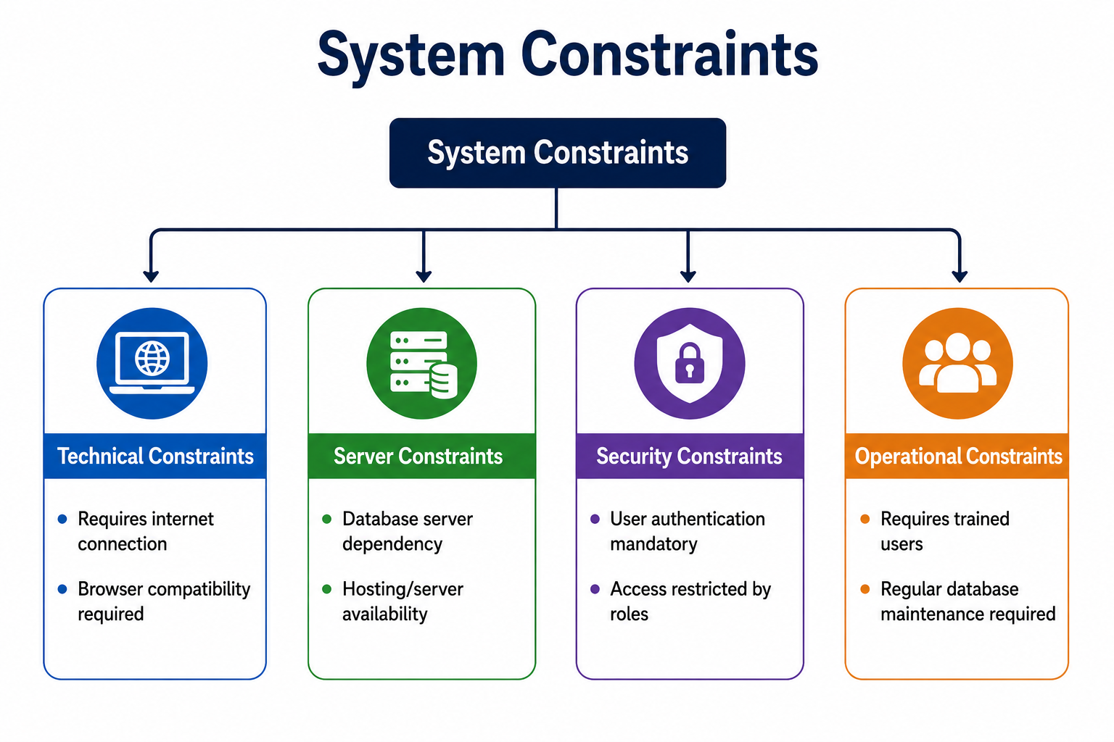
College ERP [Django] Category : DevOps using Amazon AWS
LEVEL 1 PPT PRESENTATION
3.5. SRS [UI / UX]
Limitations / Constraints
Dependency:
Django PGSQL
Internet Connection
Low Latency Hosting
Date :

Slide 15






College ERP [Django] Category : DevOps using Amazon AWS
LEVEL 1 PPT PRESENTATION
4. Process Logic
College ERP : Django & Pgsql
Frontend : HTML, CSS, JS, JQuery & Ajax
Backend : Python , Django
Database : Postgre sql Environment of Dev. : Windows Environment of Prod.: Linux (Ubuntu Free-tier) Containerization : Docker Web Hosting : Amazon Cloud Free tier Version Controlling : GitHub
Date :

Slide 16


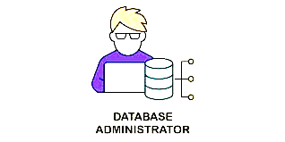



College ERP [Django] Category : DevOps using Amazon AWS
LEVEL 1 PPT PRESENTATION
4. Process Logic
College ERP : Django & Pgsql
Site Design -> Responsive Website
OOAD -> Object Oriented S.w Design Concept
Agile -> Faster Development , Integ., Deployment Linux -> Networking , BASH, Logs-analysis
Docker -> File -> image ->Container [bridges]
GitHub ->Version Controlling
DevOps -> Continuous Integration and Deployment DB Admin -> DB Setup / Design / Audit
Date :

Slide 17
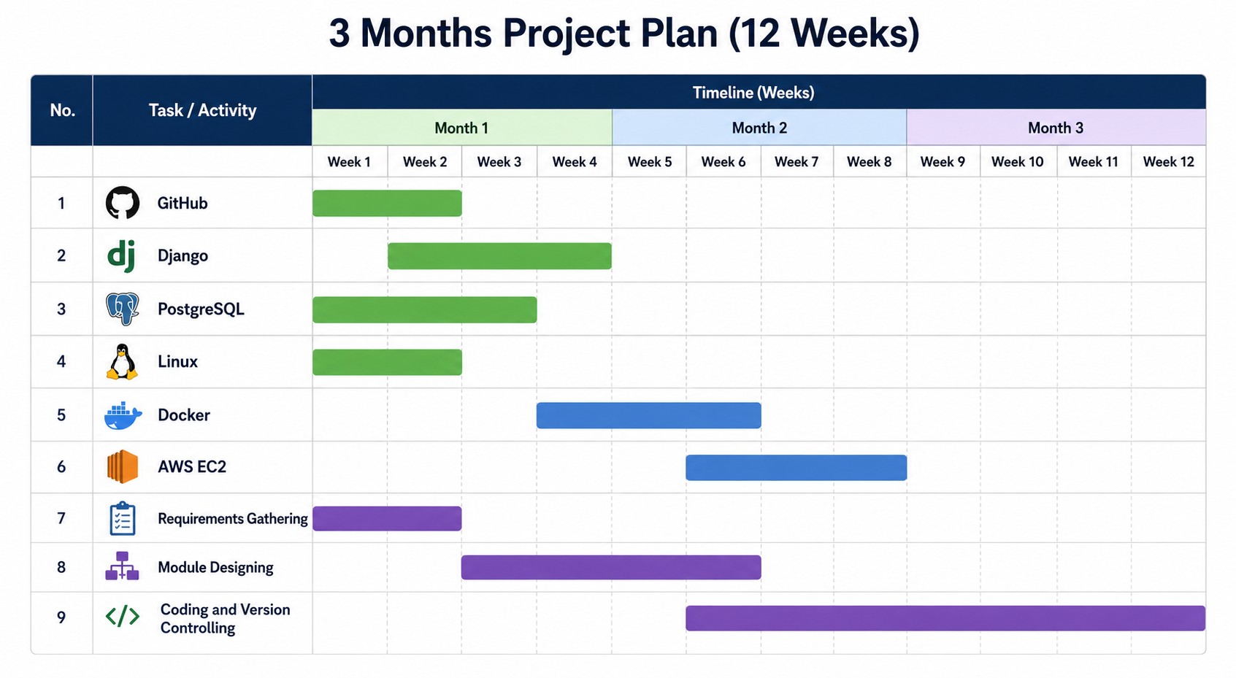
College ERP [Django] Category : DevOps using Amazon AWS
LEVEL 1 PPT PRESENTATION
5. Gantt Chart
Date :

Slide 18
College ERP [Django] Category : DevOps using Amazon AWS
LEVEL 1 PPT PRESENTATION
5. Gantt Chart
Date :
3 Months Gannt Chart (Process Based)
31-Mar | Skill Learning |  |  |  |  |  |  |  |  | 1-May |  | 31-May | 1-Jun |  | 30-Jun
 | Python
 |  | Django
 |  |  | linux
 |  |  |  | bash
 |  |  |  |  | github
 |  |  |  |  |  | postgres
 |  |  |  |  |  |  | docker
 |  |  |  |  |  |  |  | AmazonEC2
 |  |  |  |  |  |  |  |  | DNS
 |  |  |  |  |  |  |  |  |  | Requirements gathering
 |  |  |  |  |  |  |  |  |  |  |  |  | Coding & VC
 |  |  |  |  |  |  |  |  |  |  |  |  |  | Testing
 |  |  |  |  |  |  |  |  |  |  |  |  |  |  | Deployement

Slide 19
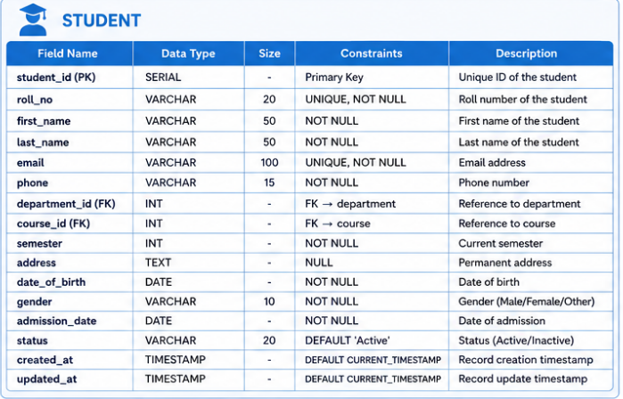
College ERP [Django] Category : DevOps using Amazon AWS
LEVEL 1 PPT PRESENTATION
6. Data Dictionary
Date :

Slide 20
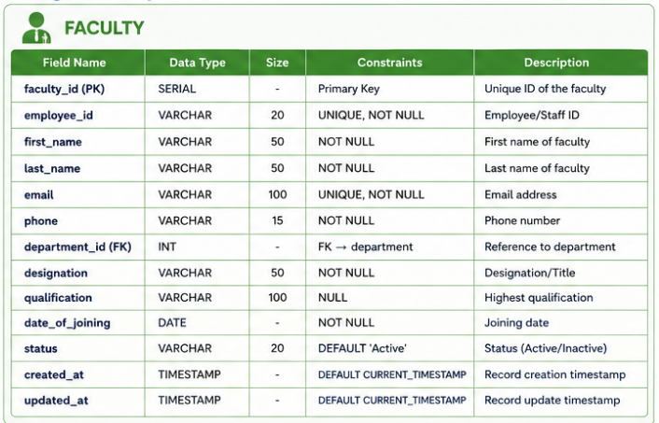
College ERP [Django] Category : DevOps using Amazon AWS
LEVEL 1 PPT PRESENTATION
6. Data Dictionary
Date :

Slide 21
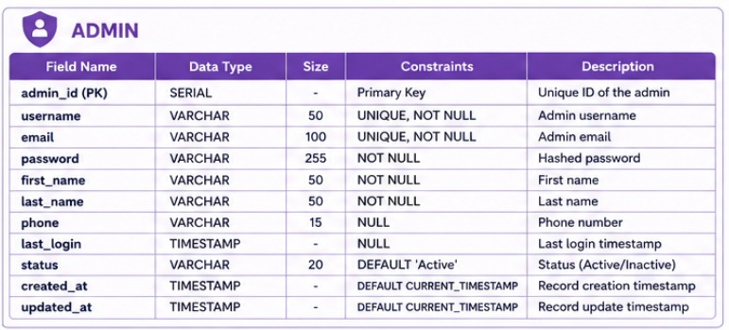
College ERP [Django] Category : DevOps using Amazon AWS
LEVEL 1 PPT PRESENTATION
6. Data Dictionary
Date :

Slide 22
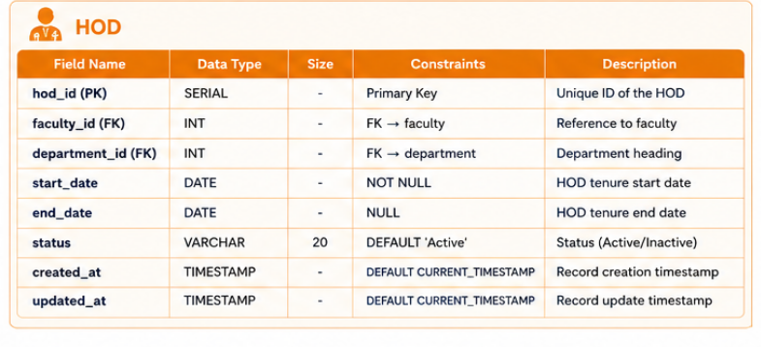
College ERP [Django] Category : DevOps using Amazon AWS
LEVEL 1 PPT PRESENTATION
6. Data Dictionary
Date :

Slide 23
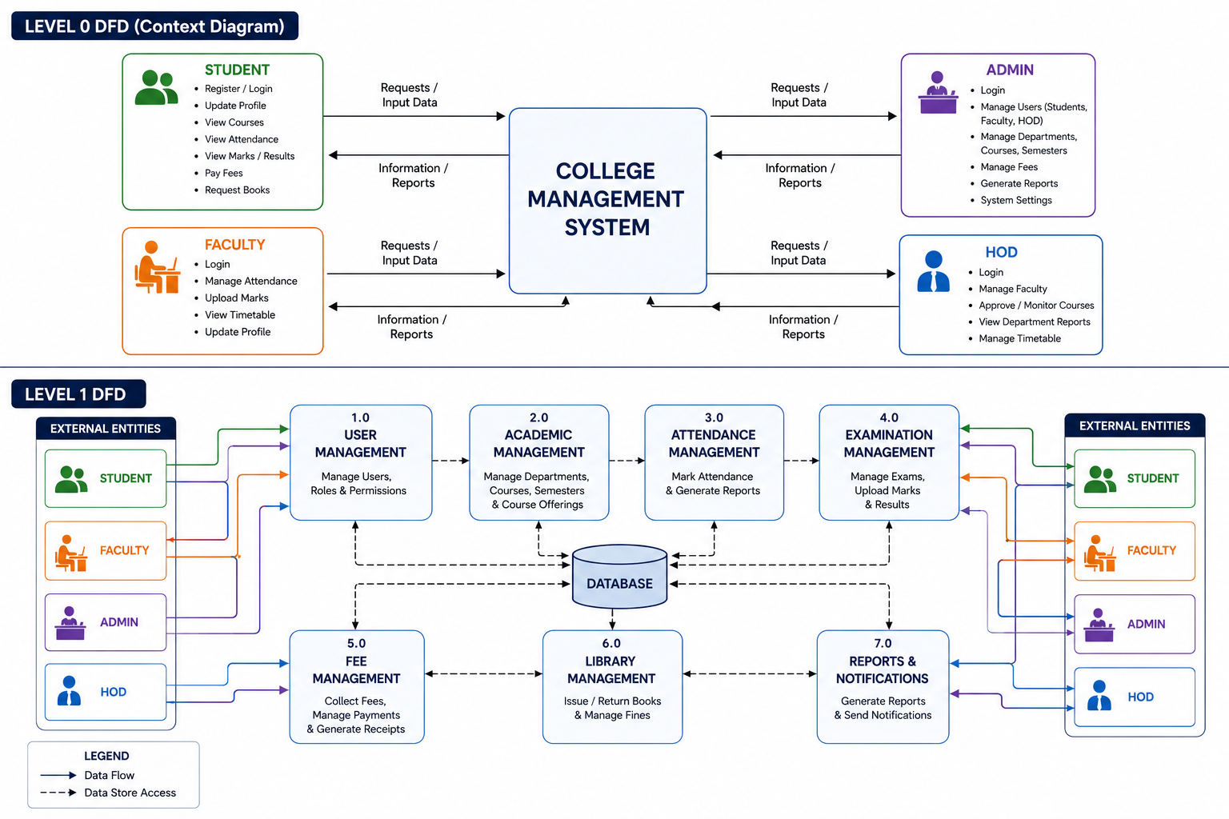
College ERP [Django] Category : DevOps using Amazon AWS
LEVEL 1 PPT PRESENTATION 7. Data Flow Diagram
Date :

Slide 24
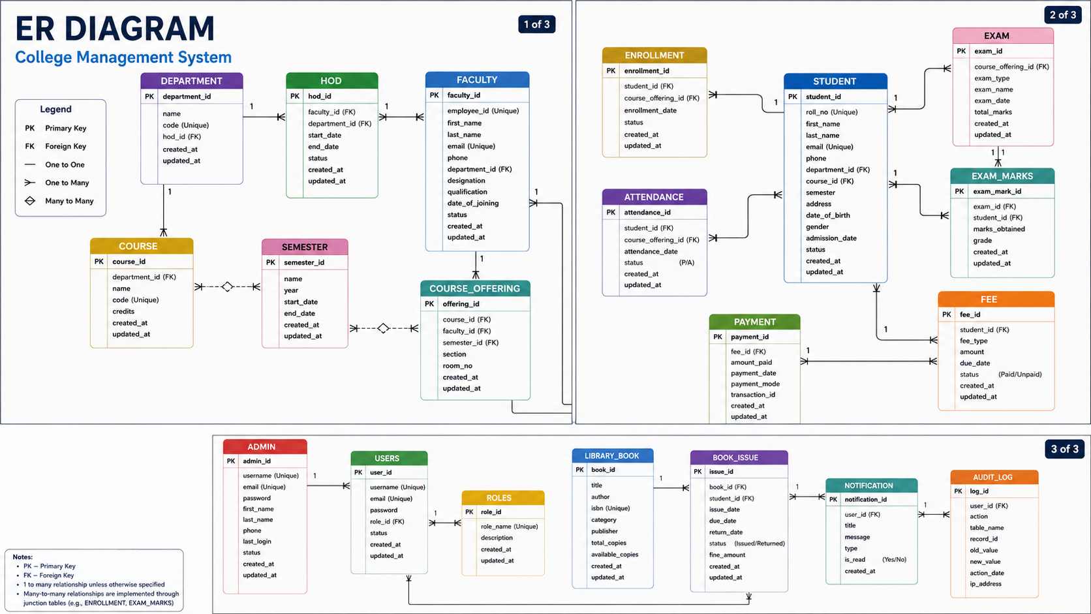
College ERP [Django] Category : DevOps using Amazon AWS
LEVEL 1 PPT PRESENTATION 8. ER Diagram
Date :

Slide 25
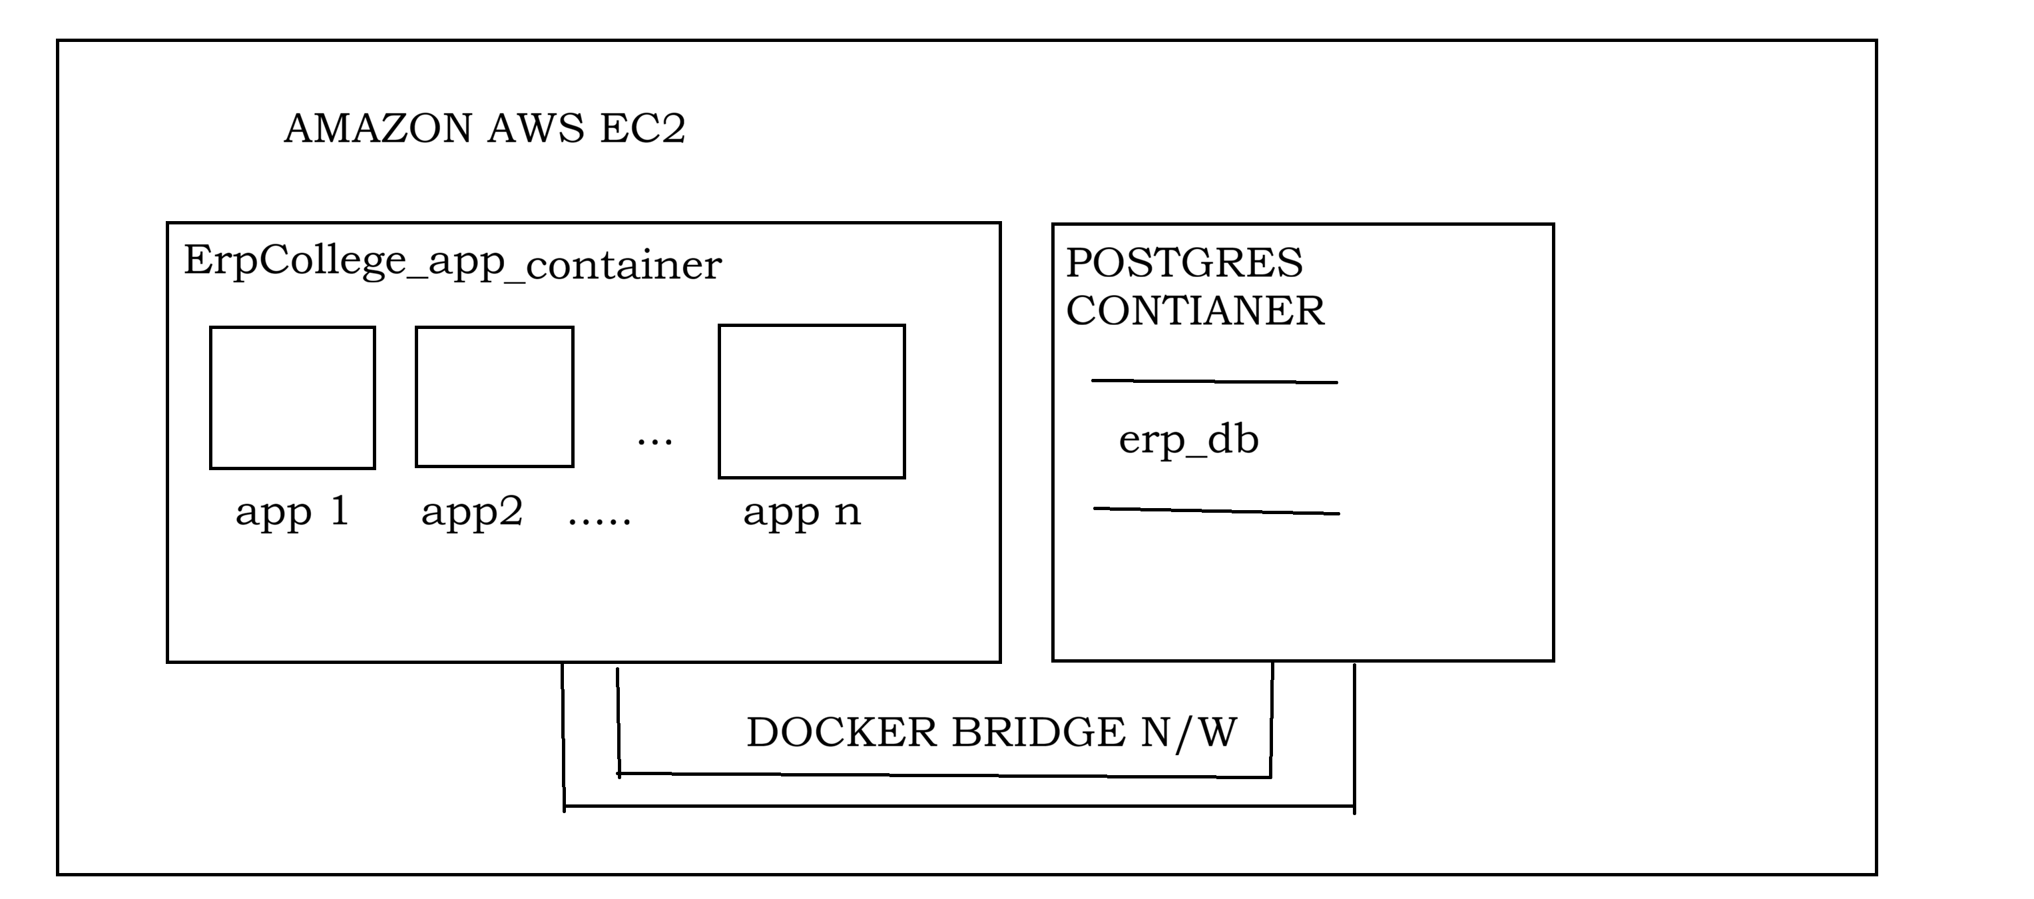
College ERP [Django] Category : DevOps using Amazon AWS
LEVEL 1 PPT PRESENTATION 9. Complete Interface
Date :

Slide 26


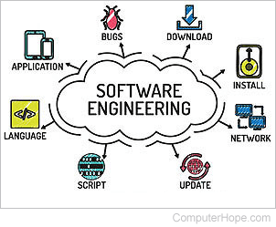
College ERP [Django] Category : DevOps using Amazon AWS
LEVEL 1 PPT PRESENTATION
10. Expected Report Generation
College ERP : Django & Pgsql Mainly, All Information being managed
Is capable for report generation and
Analysis.
(Done in .csv / .pdf form.)
Date :

Slide 27
College ERP [Django] Category : DevOps using Amazon AWS
LEVEL 1 PPT PRESENTATION
11. Future Scope of project
College ERP : Django & Pgsql 1. Since , A college is a dynamic Org.
Changes in s/w will be incorporated as need Arises.
2. Advance level for Data Analytics
For improvement of Administration / Management.
Date :

Slide 28
College ERP [Django] Category : DevOps using Amazon AWS
LEVEL 1 PPT PRESENTATION
12. References and Bibliography
Django Documentation The official documentation for the Django web framework, covering installation, models, views, templates, deployment, and advanced development concepts.
AWS Documentation Official Amazon Web Services documentation providing guides and references for cloud services, deployment, storage, networking, and security.
PostgreSQL Documentation Official PostgreSQL documentation covering SQL syntax, database administration, indexing, security, backup, and performance optimization. Docker Documentation Official Docker documentation for containerization, Docker Engine, Docker Compose, image management, and deployment workflows.
Date :

Slide 29

College ERP [Django] Category : DevOps using Amazon AWS
LEVEL 1 PPT PRESENTATION
End of Presentation
College ERP : Django & Pgsql
Date :
Thank you !

Slide 30
College ERP [Django] Category : DevOps using Amazon AWS
LEVEL 2 PPT PRESENTATION
Date :
Details of the Learner
Name : Aayush Sahay
Course : MCA 4th –AKU
Session : 2024- 2026
Enrollment : 24326711019
Guide : Dr. Amit Kumar Shukla (HOD-IT)
Institution : Cimage Center of Digital Technology
and Entrepreneurship, Patna
Course Code : 326 College Code : 711 For attainment of requirements for fulfillment of Masters in Computer Applications

Slide 31
College ERP [Django] Category : DevOps using Amazon AWS
Key Contents LEVEL 2 PPT PRESENTATION
Abstract of Lv1 ppt
Recommendations During lv1
Gantt chart
Deployment Procedure AWS EC2
Date :

Slide 32
College ERP [Django] Category : DevOps using Amazon AWS
LEVEL 1 PPT PRESENTATION
Inserting all the Required Records
To the Database
Date :

